Slide 1
Campaign
And
Advertisement
Calendar
Competitors
(Seasonal Advertisement)
Metrics Analysation
Mobile Vehicle Advertisement
Skin Bugging and Suggesting Products
Public gathering
#garinerGrowth
#greenbeauty
Winter
Summer
Biotique
Organic Harvest
Lotus
Lakme
Spring
Monsoon

Slide 2
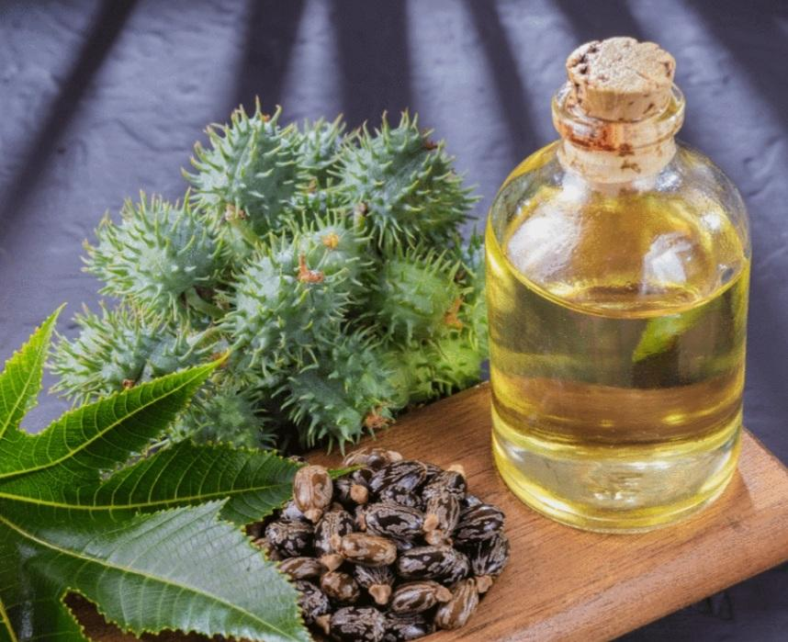
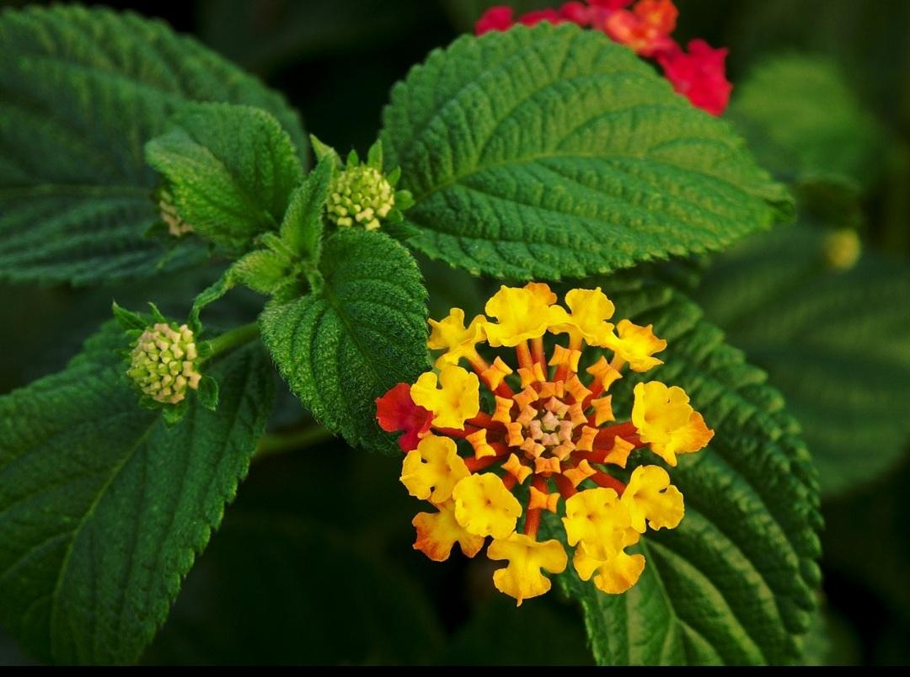
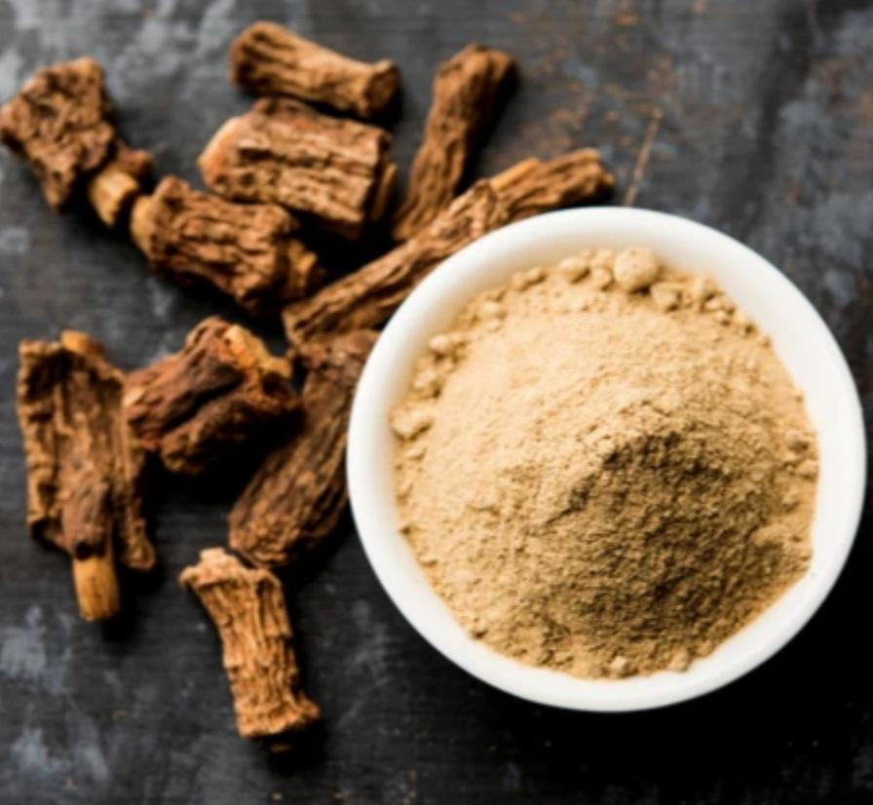
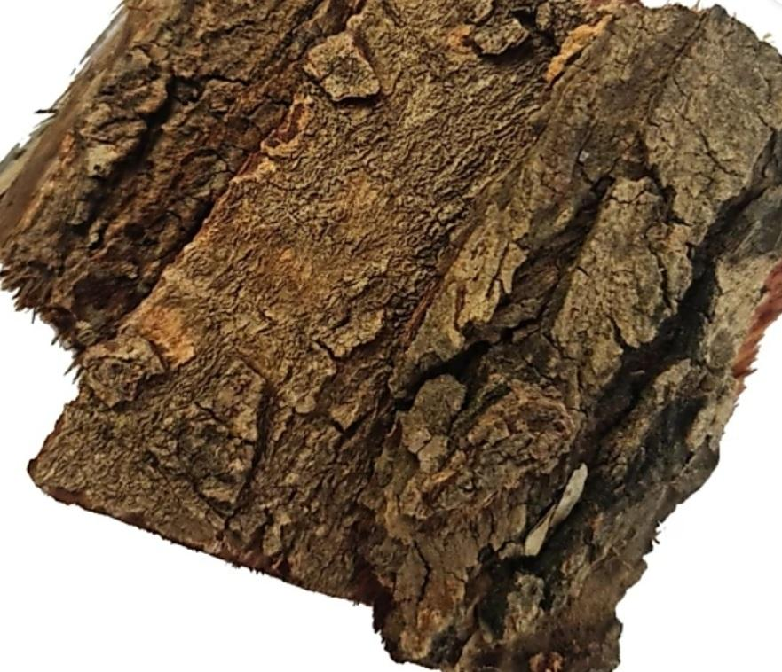

NATURE for #greenbeauty
#introducingneembark
Neembark for skin care,its root bark and fruit are used as a tonic and astringent.Icecubes of neem act as a skin softeners and reducing scar on skin .
Introducing LATANA CAMARA a species of flowering plant within verbena family native American and Indian tropics.
Many typical villagers in India uses its extracted oil in winter for preventing skin from sunburn and sunscreens.
Laxative ,antiviral,thickening,vitamin e,coldpressed property,peptidic property ofcastor oil if included in product may result in successful customer feedback for skin and hair.

Slide 3


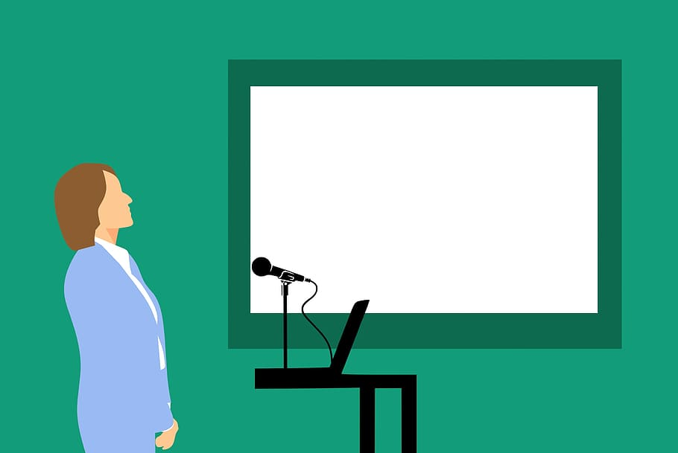



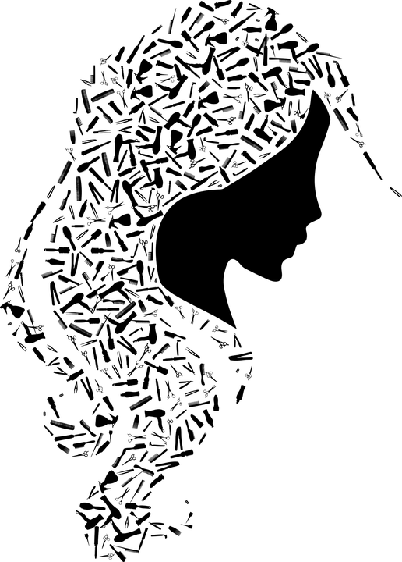

Tie Ups
Trade Engagement
1
1
2
Youtubers and Influencers
Branding And Prioritization
Seminars And Competition
2
2
4
Seminars And Competition
Ecom
Discount Partnership
Digital Marketing Company
3
3
Digital Marketing Company
Customer Executives and Skin Helpers
4
4
Beauty Parlour Associations
Video reviews
3
Beauty Parlour Associations

